Slide 1
Data Mining DS-303
Lecture 1
Muhammad Arham
Lecturer
The University of Faisalabad

Slide 2
Introduction to Data Mining

Slide 3
What is data mining?
Data mining is the practice of automatically searching large stores of data to discover patterns and trends that go beyond simple analysis.
Data mining uses sophisticated mathematical algorithms to segment the data and evaluate the probability of future events.

Slide 4
What is data mining?
Data mining (Knowledge discovery from data)
Extracting of interesting (Non-trivial, Implicit, previously unknown, and potentially useful) patterns or knowledge from a huge amount of data.
Alternative names
Knowledge discovery (mining) in databases (KDD), Knowledge extraction, data/pattern analysis, data archeology, data dredging, information harvesting, business intelligence, etc.
Watch Out: Is everything “Data mining”?
Simple search and query processing
(Deductive) expert systems
Data mining ≠ querying or expert systems
Notes:
Non-trivial – not obvious or simple to find
Implicit – hidden within the data
Previously unknown – not already identified
Potentially useful – valuable for decision-making or prediction
3.
Simple search and query processing
This involves retrieving information using predefined queries (like SQL).
It answers explicit questions
Results are direct and obvious
No new patterns or knowledge are discovered
Example: “Find all customers who bought product X last month.” This is not data mining—it’s just data retrieval.
(Deductive) Expert systems
Expert systems use predefined rules and human expertise to make decisions.
Knowledge is manually encoded
Reasoning is deductive (if–then rules)
Does not learn from data
Example: “If income > X and credit score > Y, approve loan.” This is rule-based reasoning, not data mining.

Slide 5
Why data mining?
Too much data and too little information
There is a need to extract useful information from the data and to interpret the data.
It is a process of discovering interesting knowledge from large amounts of data stored either in databases, data warehouses, or other information repositories.

Slide 6
Why data mining?
Rapid Computerization of buisnesses produce huge amount of data
How to make best use of data?
A growing realization that knowledge discovery from data can be used for competitive advantage.
Notes:
Organizations increasingly realize that discovering knowledge from data—rather than just storing or querying it—can provide a strong competitive advantage. By analyzing large volumes of data, businesses can uncover hidden patterns, customer behaviors, market trends, and risks that competitors may not see.
This insight allows companies to:
Make better strategic decisions
Improve efficiency and profitability
Anticipate customer needs and market changes
Innovate faster than competitors

Slide 7
Why Data Mining is Important
Explosion of digital data
With the explosion of digital data from sources like transactions, social media, sensors, and the web, the volume of data has grown far beyond what humans can analyze manually.
Manual analysis is impossible at scale
Manual analysis is impossible at this scale, making automated techniques essential
Helps in:
Better decision making
Prediction and forecasting
Automation of insights
Competitive advantage for organizations
Providing a competitive advantage by enabling faster, smarter, and more informed strategies

Slide 8
Process of Data Mining
Data mining involves a combination of several techniques and technologies that help in discovering patterns, trends, and insights from data. It includes:
Data Collection and Integration: The process starts with gathering large amounts of data from various sources, such as transactional databases, data warehouses, or even the web. This data is then integrated to create a dataset for analysis.
Data Preprocessing: This step includes removing noise(errors), handling missing values, and transforming data into a suitable format for analysis.
Pattern Recognition and Machine Learning: These techniques are used to identify patterns, correlations, and trends within the data. Machine learning algorithms such as clustering, classification, and regression help uncover hidden insights that drive decision-making.
Notes:
These techniques analyze large datasets to identify patterns, correlations, and trends that are difficult for humans to detect manually. By learning from historical data, machine learning models can generalize and make predictions or decisions on new data.
Common machine learning methods used in data mining include:
Clustering – grouping similar data objects without predefined labels
Classification – assigning data items to predefined categories
Regression – modeling relationships between variables to predict continuous values
Together, pattern recognition and machine learning help uncover hidden insights, support data-driven decision-making, and improve prediction accuracy across various applications.

Slide 9
Process of Data Mining
Statistical Analysis: Statistics is used to understand how different factors are related or how strong those relationships are, and whether the patterns we see are meaningful or not.
Evaluation and Interpretation: After patterns are identified, it's important to check how relevant and significant they are. The results are presented through visualizations or reports to help businesses understand the data and make informed decisions.
Data Presentation and Visualization: It is very important to share the findings clearly. Visualization tools such as graphs, charts, and dashboards are used to present the insights in an easily understandable format.

Slide 10
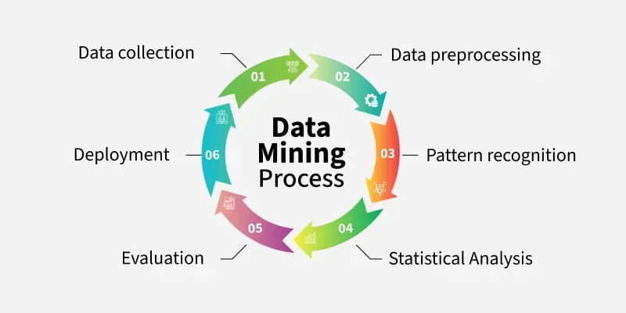

Slide 11
Applications

Slide 12
Applications of Data Mining
Here are some key areas where data mining is commonly applied:
Fraud Detection: Data mining plays an important role in detecting fraudulent activities in various industries. In banking, it helps identify suspicious credit card transactions by recognizing abnormal spending patterns. Similarly, in insurance, it helps spot fraudulent claims by analyzing historical data and identifying inconsistencies.
Anomaly Detection: Anomaly detection identifies unusual patterns that differ from normal behavior. This application is particularly useful in security, where it can help detect cyberattacks, system intrusions, or unusual network traffic.
Notes:
Fraud Detection:Data mining helps detect fraudulent activities by analyzing large volumes of transactional and historical data to identify unusual or abnormal patterns. Similarly, in the insurance industry, data mining analyzes past claim records to identify inconsistencies, repeated claims, or abnormal patterns that may indicate fraud. By recognizing these patterns early, organizations can reduce financial losses, improve security, and take preventive actions.

Slide 13
Applications of Data Mining
Supply Chain Optimization: It helps in improving how supply chains work by analyzing demand, production, and distribution patterns. It helps manage inventory, predict shortages, and optimize logistics, thereby cutting costs and improving delivery times.
Traffic Management: Traffic systems use data mining to predict congestion, make traffic flow smoother, and reduce accidents. By looking at real-time traffic data, cities can make better decisions on things like infrastructure, traffic signals, and routes.
Financial Market Analysis: In finance, data mining is used to analyze market trends, predict stock movements, and identify investment opportunities. It helps with portfolio management by evaluating the risk and return of different investments and spotting possible issues in the market.
Notes:
Manage inventory efficiently – ensuring the right products are available at the right time
Predict shortages or excess stock – reducing waste and preventing stockouts
Optimize logistics and distribution – improving transportation routes and delivery schedules
Reduce costs and improve delivery times – making the supply chain faster, more efficient, and cost-effective

Slide 14
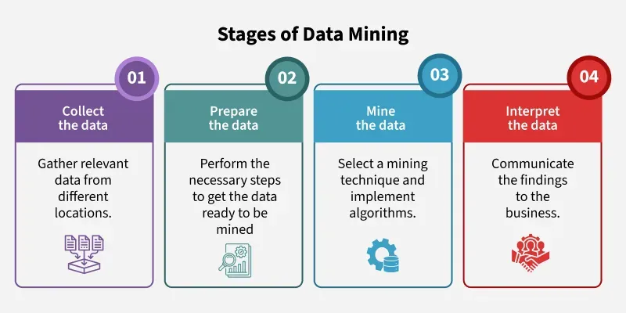

Slide 15
Applications of Data Mining
Business: Customer profiling, churn prediction
Healthcare: Disease prediction, patient analysis
Finance: Credit scoring, fraud detection
Retail: Market basket analysis
Education: Student performance prediction
Cybersecurity: Intrusion detection
Notes:
Churn prediction is the proactive identification of at-risk customers likely to cancel subscriptions or stop using services, utilizing machine learning, historical, and behavioral data.
An intrusion detection system (IDS) is an application that monitors network traffic and searches for known threats and suspicious or malicious activity.

Slide 16
Advantages of Data Mining
The data mining process has many benefits including,
Operational Efficiency and Automation: It helps to automate repetitive tasks like cleaning data, spotting unusual patterns, and generating reports. This saves time and resources, allowing teams to focus on more important work, which leads to increased productivity.
Fraud Detection and Anomaly Identification: It detects fraudulent behavior by identifying unusual patterns in financial transactions, insurance claims, and digital activity. This enhances security and reduces financial losses.

Slide 17
Advantages of Data Mining
Risk Management and Compliance: By analyzing historical data and real-time indicators, data mining helps identify operational, financial, and strategic risks. It makes it easier to assess risks, stay compliant with regulations, and plan for unexpected situations.
Improved Resource Allocation: It helps optimize resource allocation by identifying which initiatives, products, or customer segments generate the highest returns. This makes budgeting, staffing, and investment decisions smarter and more efficient.

Slide 18
Challenges in Data Mining
Data Quality and Preprocessing: Raw data is often noisy, incomplete, or inconsistent, which makes it hard to pull out useful insights.
Data Privacy and Security: Handling sensitive data requires strict measures to ensure privacy and comply with regulations like GDPR. Protecting against unauthorized access and misuse of data is a major concern in data mining.
Overfitting and Underfitting: In machine learning, overfitting occurs when models learn noise instead of general patterns, while underfitting happens when the model fails to capture important trends, leading to poor predictions.

Slide 19
Common Data Mining Techniques
Decision Trees
Naïve Bayes
k-Nearest Neighbors (KNN)
Support Vector Machines (SVM)
Neural Networks
Apriori Algorithm
k-Means Clustering

Slide 20
Tools & Software
Python (NumPy, Pandas, Scikit-learn)
R
WEKA/Orange/knime
RapidMiner/Gaphi/Citespace
Apache Spark / Hadoop
SQL-based tools

Slide 21
Reference
https://www.youtube.com/watch?v=dUm3ptTQr0Q
https://www.geeksforgeeks.org/data-science/introduction-to-data-mining/
https://www.slideshare.net/slideshow/introduction-to-data-mining-250399474/250399474
https://www.slideshare.net/slideshow/data-mining-applications-78279442/78279442

Slide 22
Advice
Kindly read the book before and after the lecture, if some terms/ words are not covered in the lecture, if appear in exam it might not appear strange or out of course.

